Slide 1
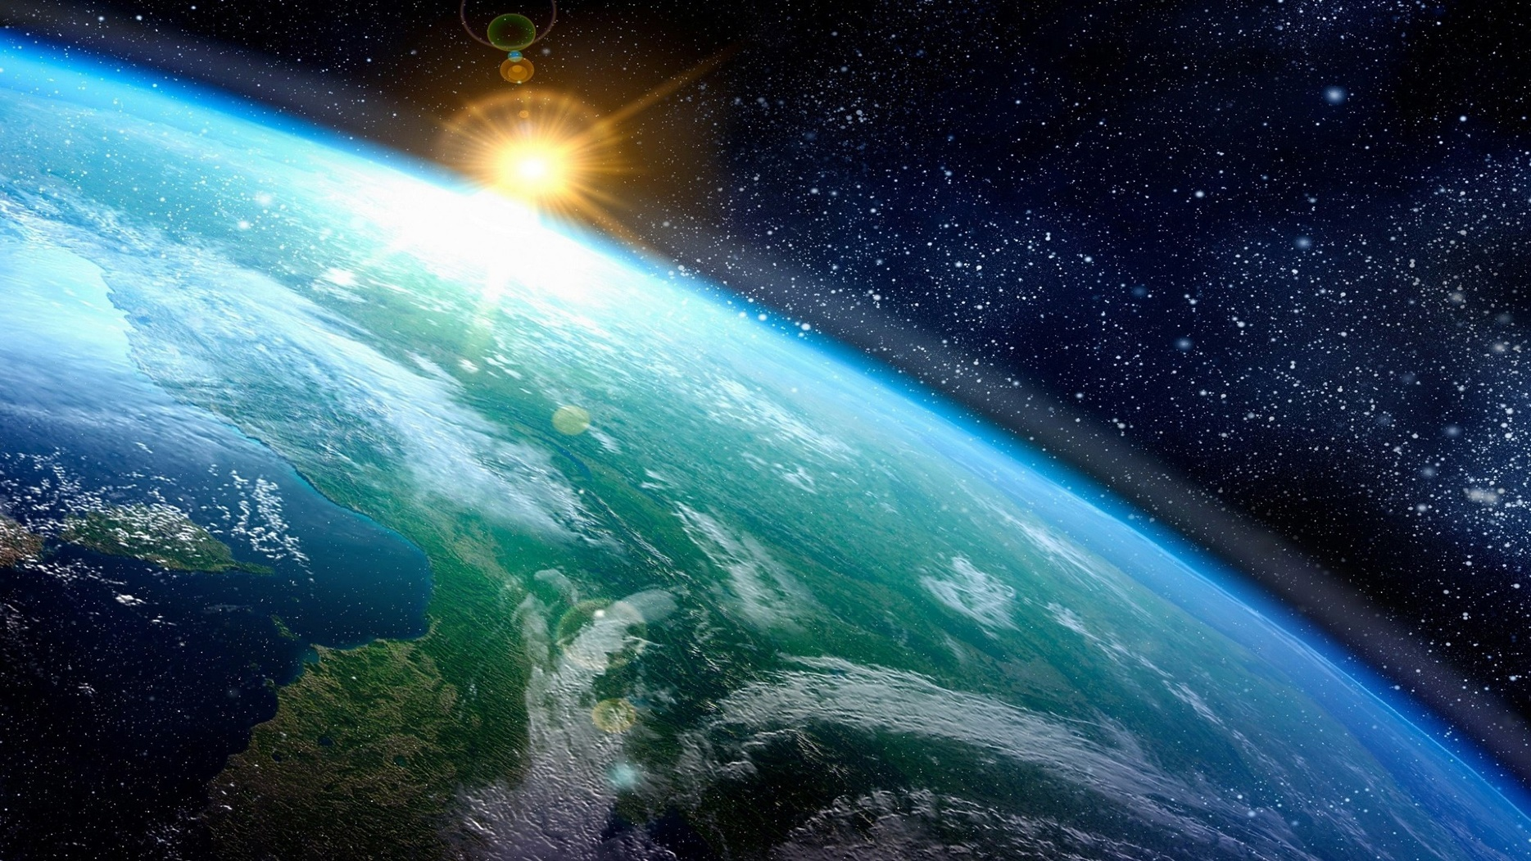
LAUDATO SI’:
AN INTEGRAL VISION for ACTION
Joshtrom Isaac Kureethdam SDB
Coordinator of the «Ecology & Creation» Sector
Vatican Dicastery for Promoting Integral Human Development

Slide 2
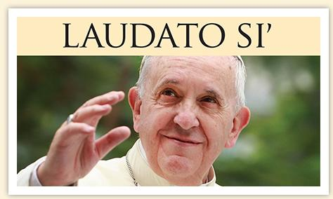
… the most important environmental text of the 21st century
(Dale Jamieson)

Slide 3
… An INTEGRAL vision
«… human life is grounded
in three fundamental and closely intertwined relationships:
with God, with our neighbour
and with the earth itself.»
(Laudato Si’, 66)

Slide 4
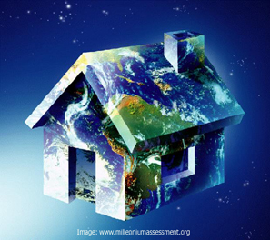
  1.
  Earth as ‘common home’ rather than just ‘environment’

Slide 5
The encyclical of Pope Francis
Laudato si’ significantly carries the sub-title:
“on care for our common home”.
In talking about Earth as our common home,
Pope Francis ushers in a major paradigm shift.
It is the crisis of our very common home!

Slide 6
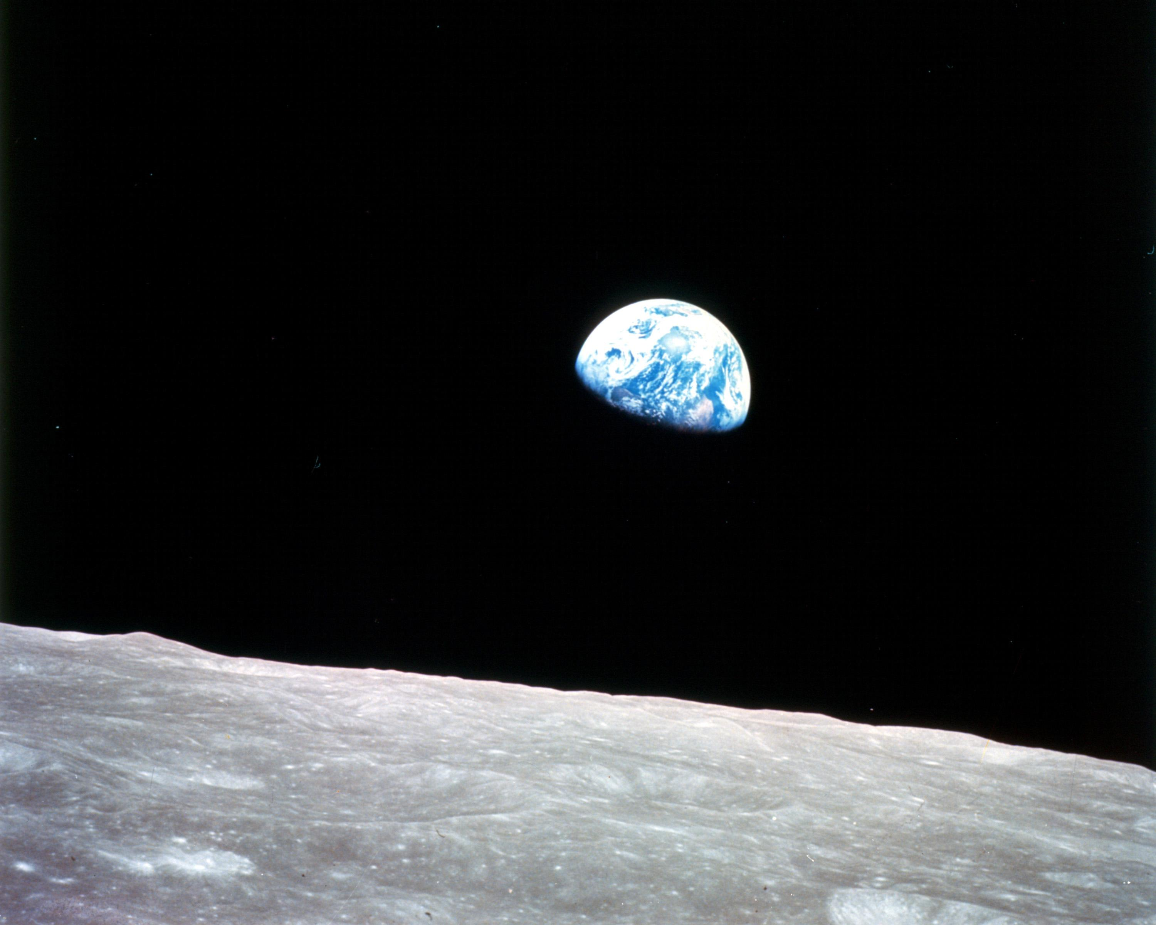

Slide 7
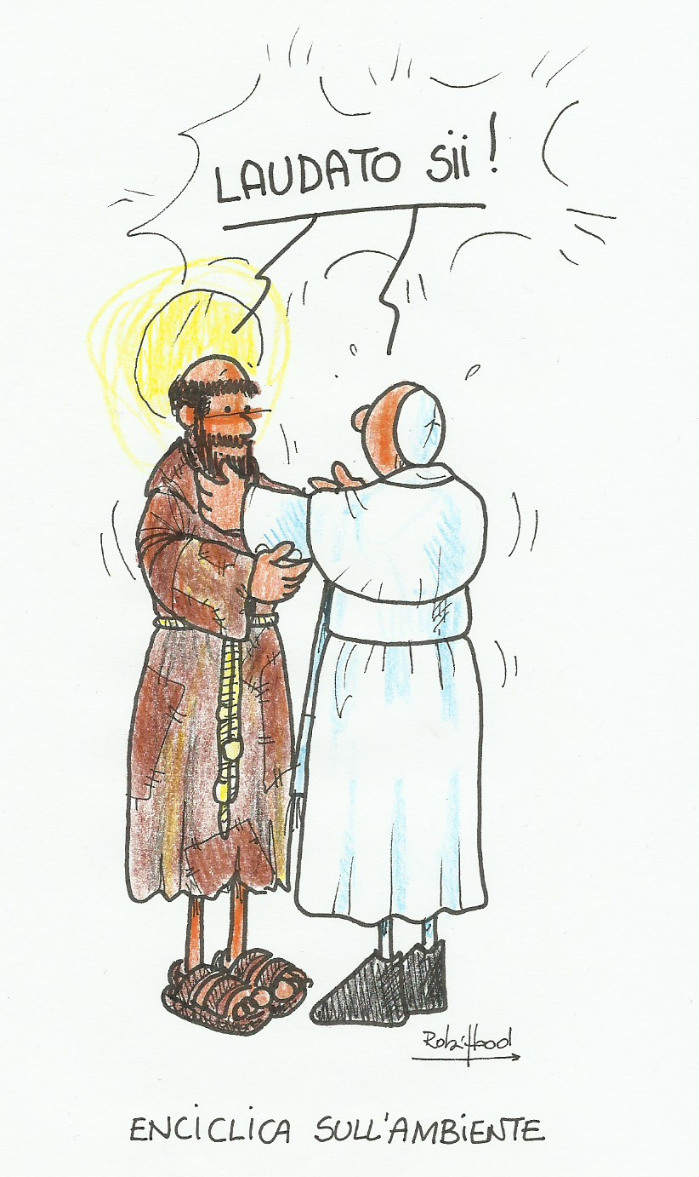
  “Francis,
  go and repair
  my house
  which, as you see,
  is falling into ruin.!
  (1205 – Assisi)

Slide 8
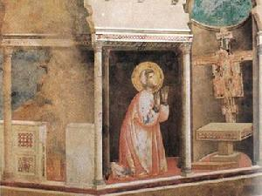
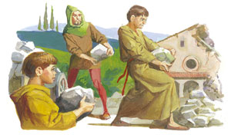

Slide 9
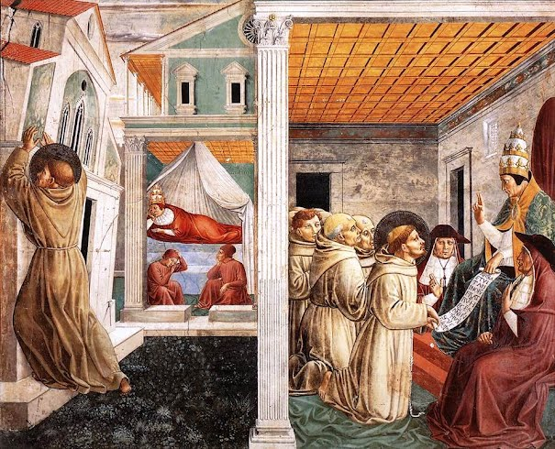

Slide 10
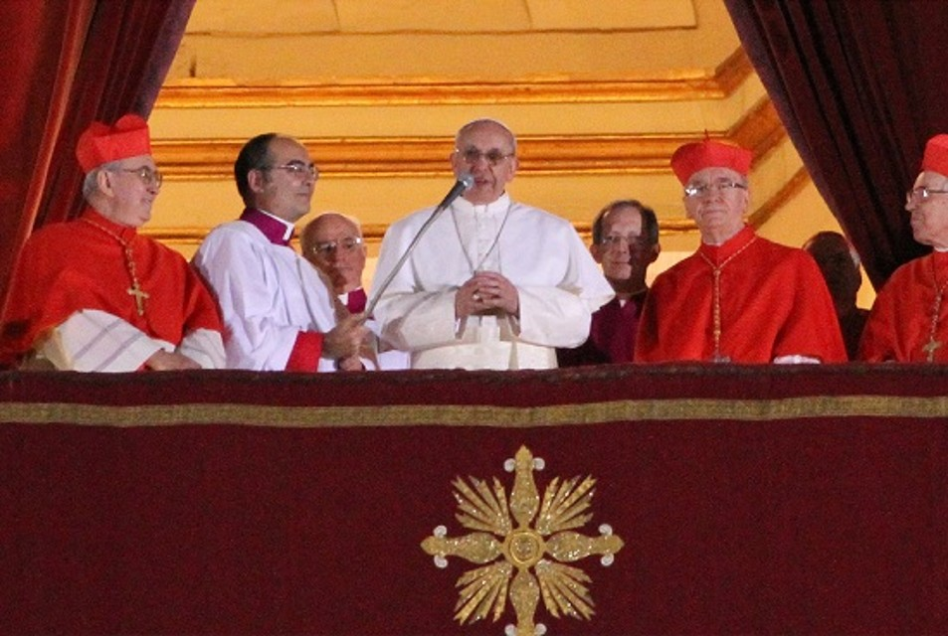
2013

Slide 11
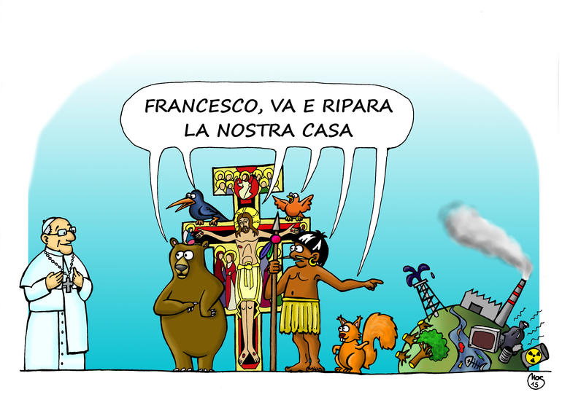
Fran
Francis, go and repair our home!

Slide 12
In Laudato Si’, Pope Francis invites the Churches, religions and all people of good will, to care for our fragile planetary home, before it is too late.
«I urgently appeal, then, for a new dialogue
about how we are shaping
the future of our plan­et.»
(Laudato Si’, 14)

Slide 13
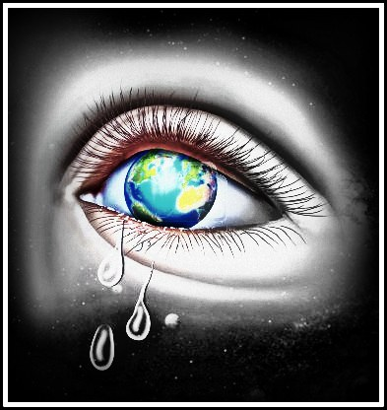
  2.
  A comprehensive understanding of the ‘crisis of our common home’
  THE CRY OF THE EARTH

Slide 14
In Laudato Si’ Pope Francis offers a masterly synthesis of the manifold manifestations of the contemporary ecological crisis, the crisis of our very home: pollution and waste, climate change, depletion of natural resources, especially water, and biodiversity loss.

Slide 16
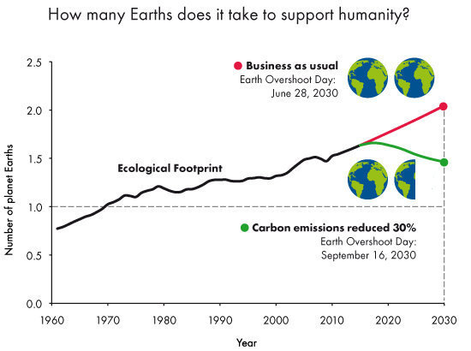

Slide 17
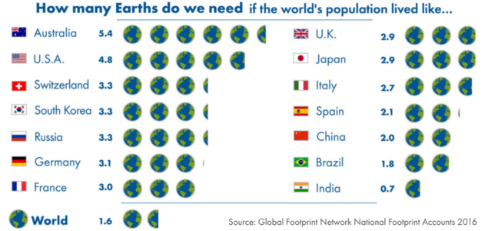

Slide 18
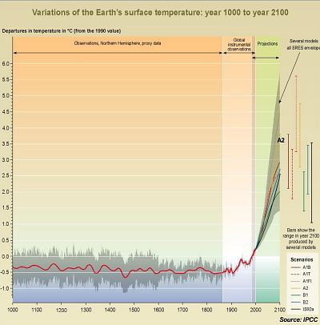

Slide 19
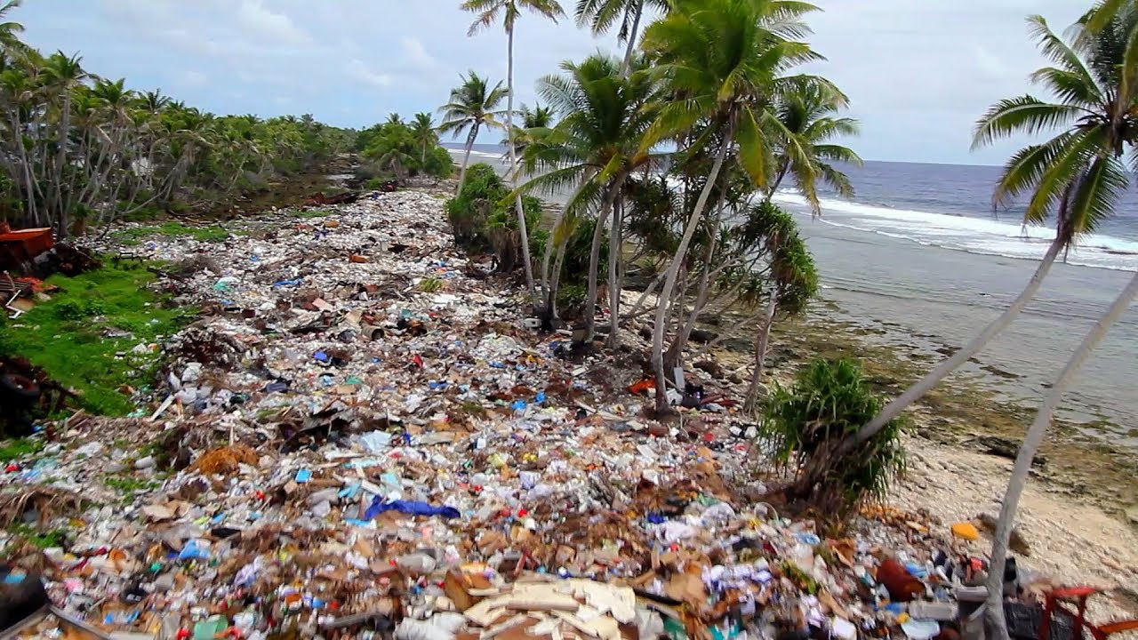
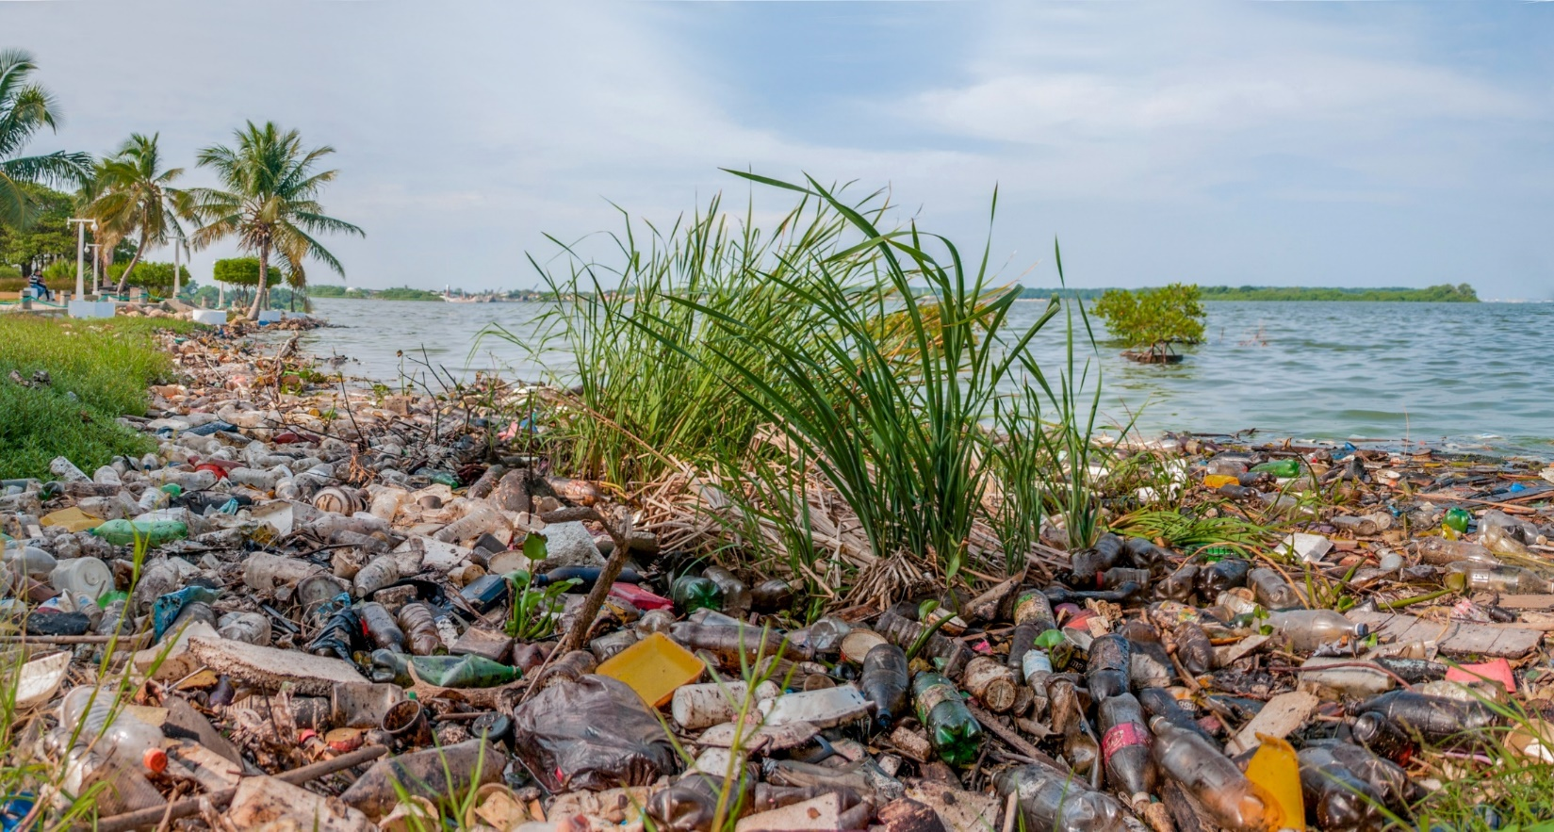

Slide 20
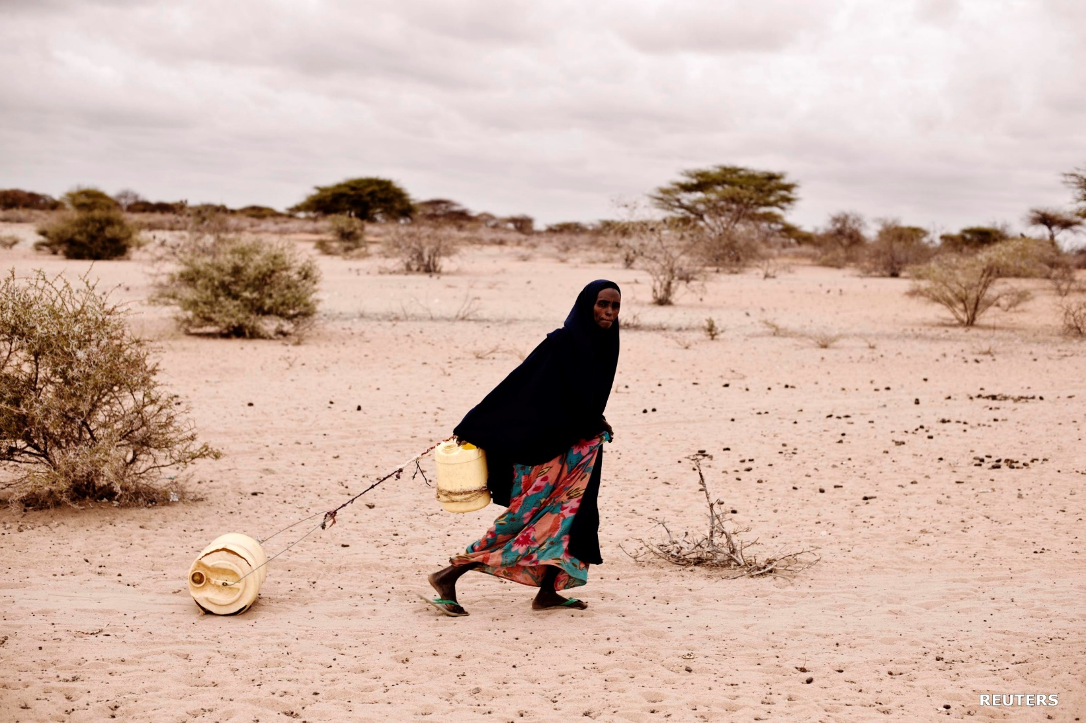

Slide 21
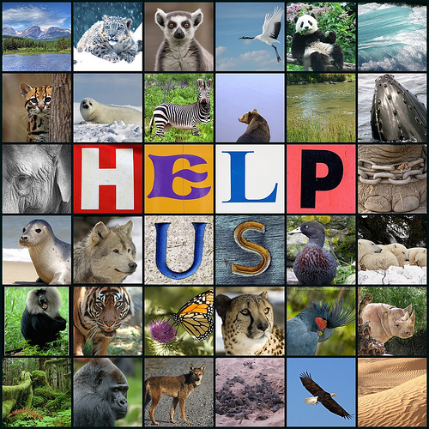

Slide 22
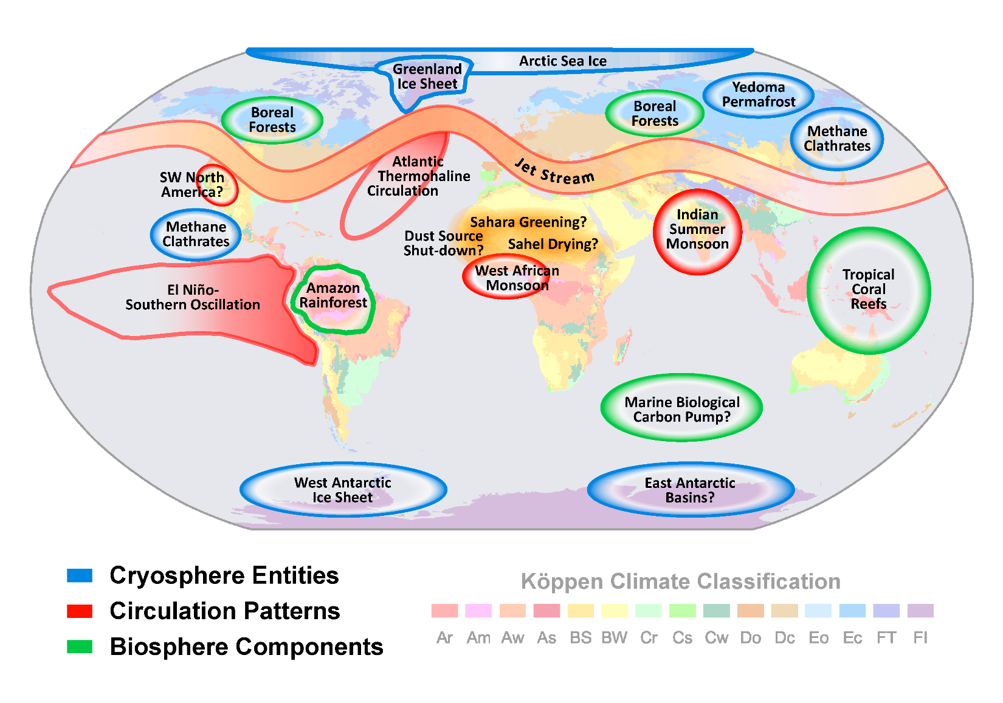
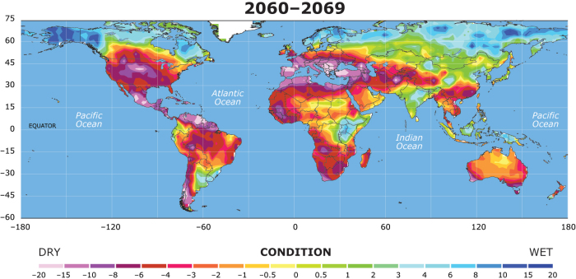

Slide 23
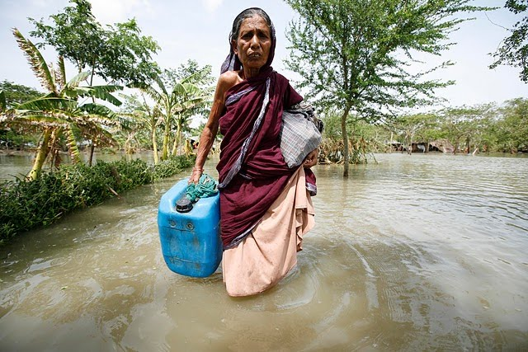
  3.
  Attentive to the
  CRY OF THE POOR (LS, 49)

Slide 24
“Both everyday experience and scientific research show that the gravest effects of
all attacks on the environment
are suffered by the poorest”.
(Laudato Si’, 48)
Laudato Si’ is, in fact, a social encyclical
than one on climate change.
“Climate” is mentioned just 14 times in the text, while “the poor,” 59 times.

Slide 25
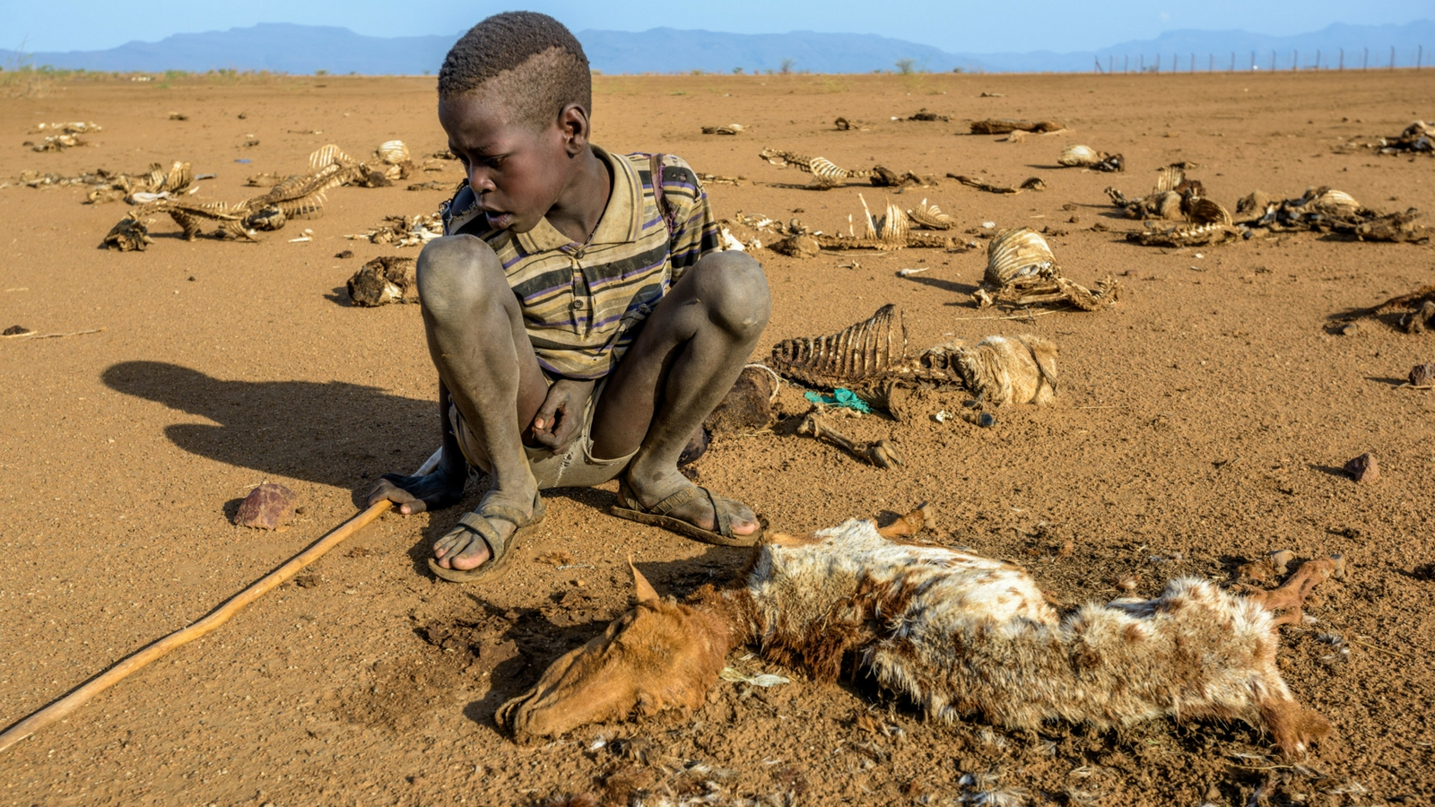
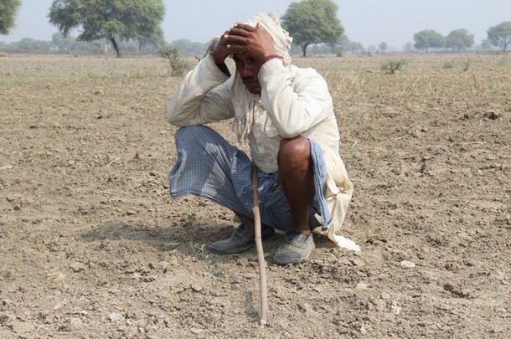

Slide 26
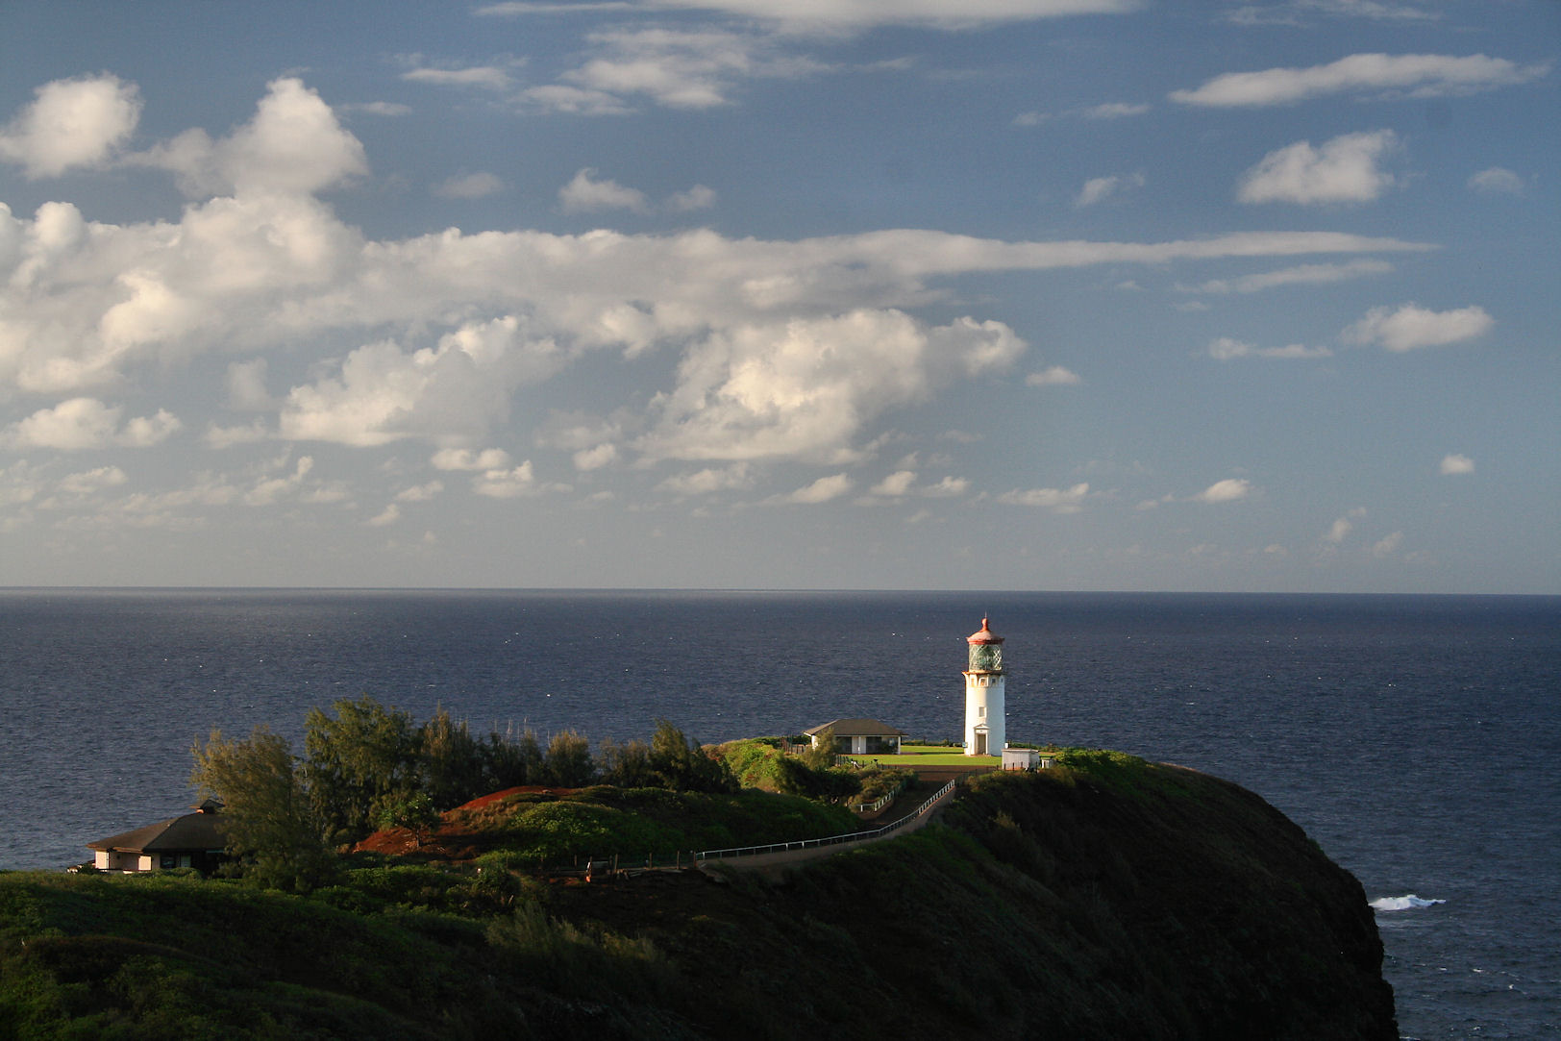
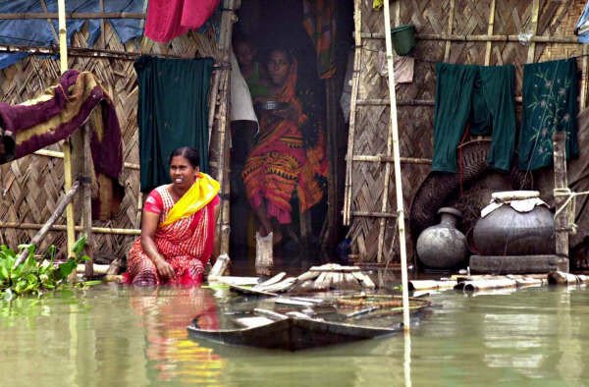

Slide 27
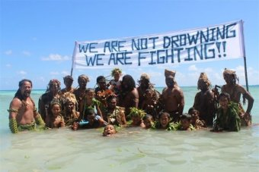

Slide 28
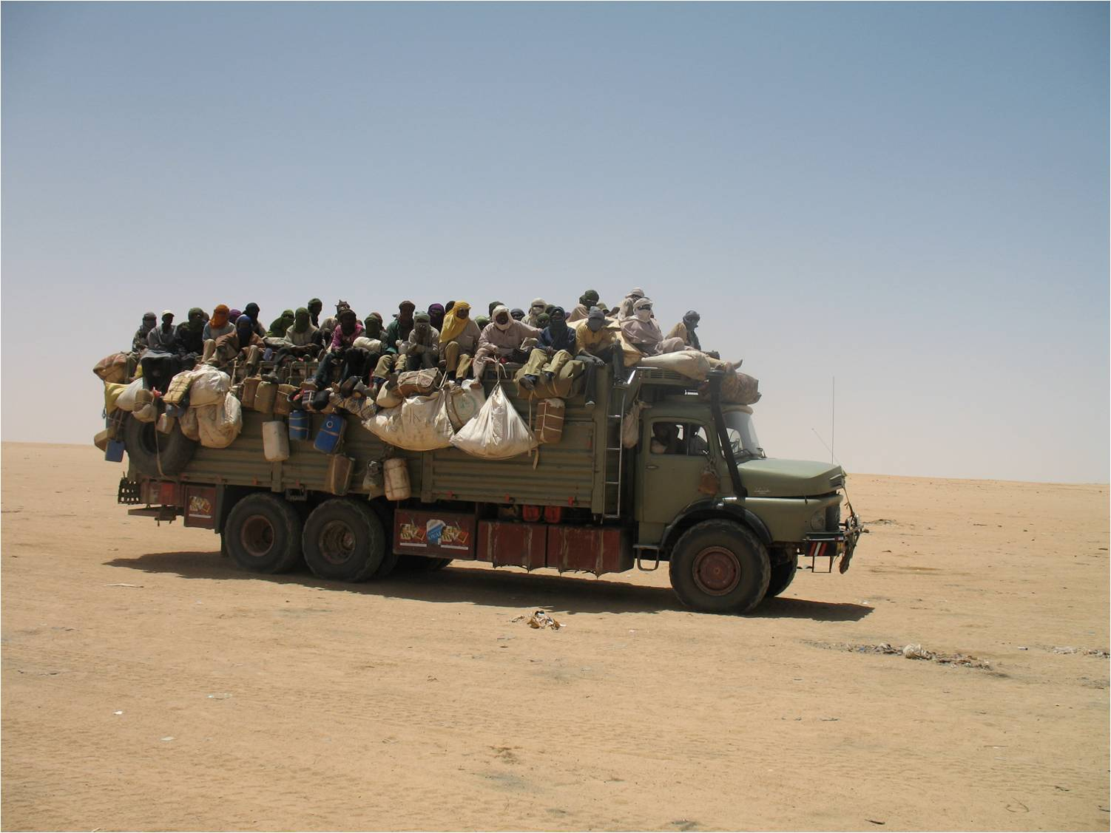

Slide 29
The richest 10% of humanity (c. 630 million people) accounted for 52% of the cumulative emissions …
[the richest 1% alone was responsible for 15%]
The 40% of humanity in the global middle class
(c. 2.5 billion people) accounted for 41% of the cumulative emissions.
The poorest 50% (c. 3.1 billion people) were responsible for just 7% of cumulative emissions.
(OXFAM, Confronting Carbon Inequality,
21 September 2020)

Slide 31
According to Pope Francis:
“Today, however, we have to realize that a true ecological approach always becomes a so­cial approach; it must integrate questions of jus­tice in debates on the environment, so as to hear both the cry of the earth and the cry of the poor”.
(Laudato Si’, 49
– italics as in the original)

Slide 32
The Pope decries the fact that on the global arena “there is little in the way of clear awareness of problems which especially affect the excluded”. (49)
The poor are conveniently forgotten or ignored at the High Table of world affairs.
Yet, as the Pope points out,
“they are the majority of the planet’s population, billions of people”. (49)

Slide 33
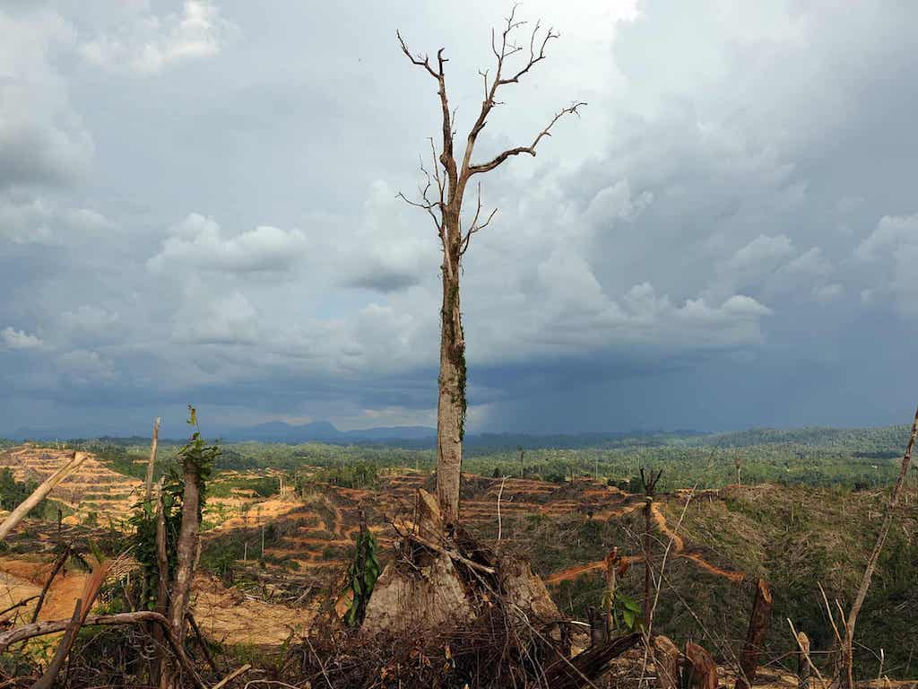
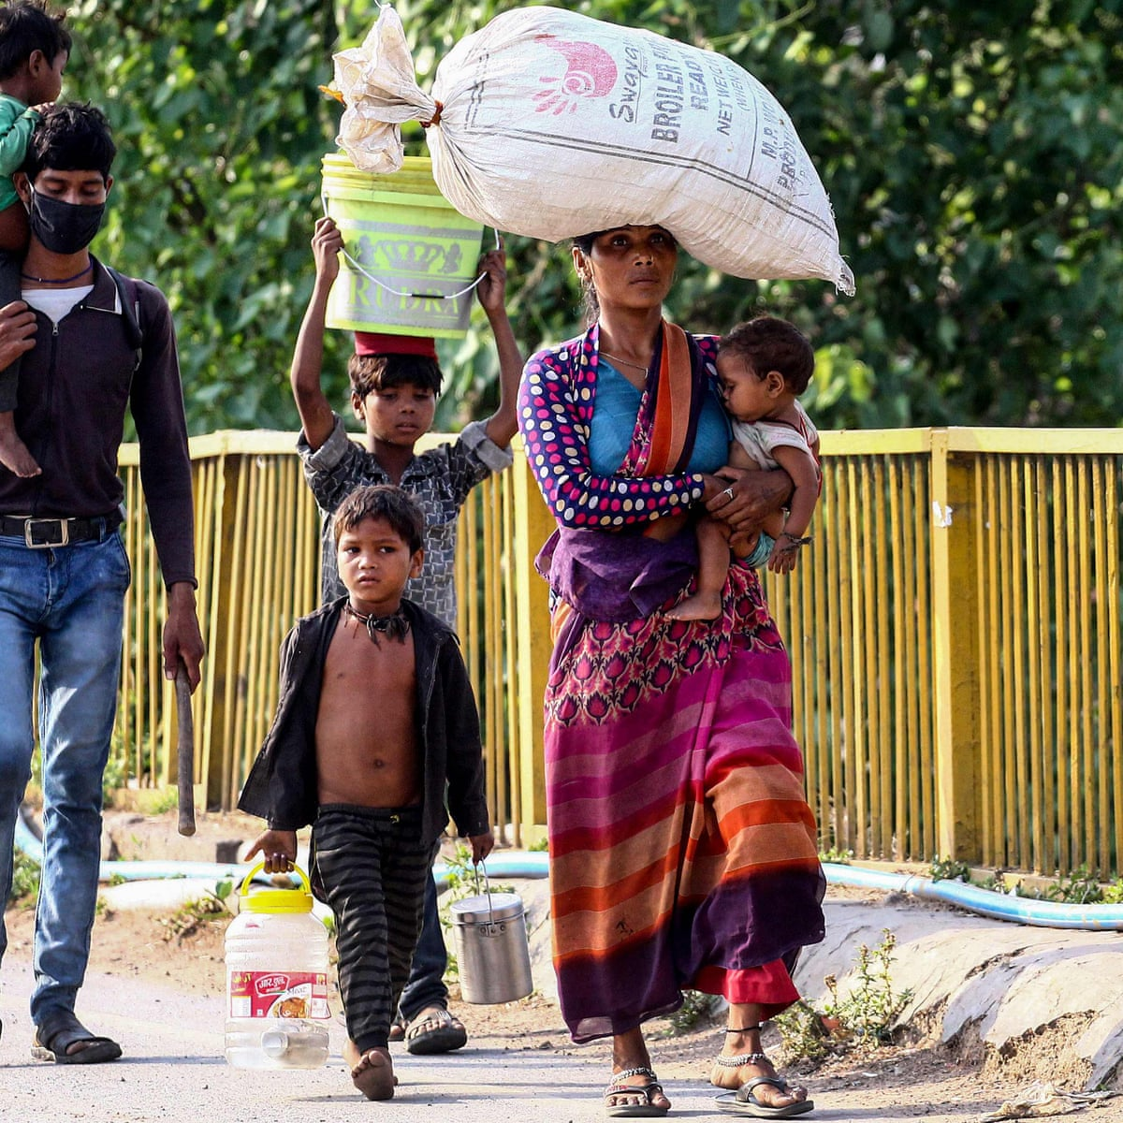
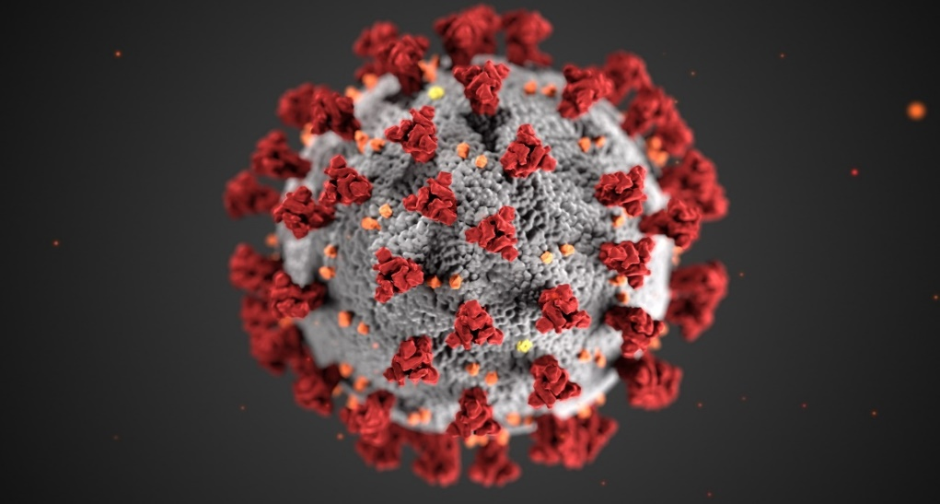

Slide 34
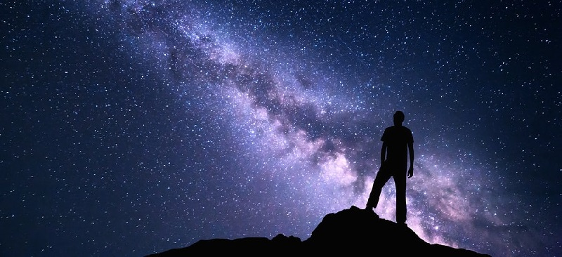
  4.
  The ‘Gospel’ of Creation …

Slide 35
… faith convictions can offer Christians, and some other believers as well, ample motivation to care for nature and for the most vulnerable of their brothers and sisters.
(Laudato Si’, 64)

Slide 36
Creation is God’s first and primordial revelation.
According to Pope Francis, “God has written a precious book, ‘whose letters are the multitude of created things present in the universe’.” (85)
Creation is, indeed, the very first epiphany of God.

Slide 37
Caring for our common home is our original vocation
The stewardship of the earthly garden is the first and primary task entrusted to Adam - the first human being, as we read in the creation narratives in Genesis.
It is the very first commandment given to humanity, our original “job description”!.

Slide 38
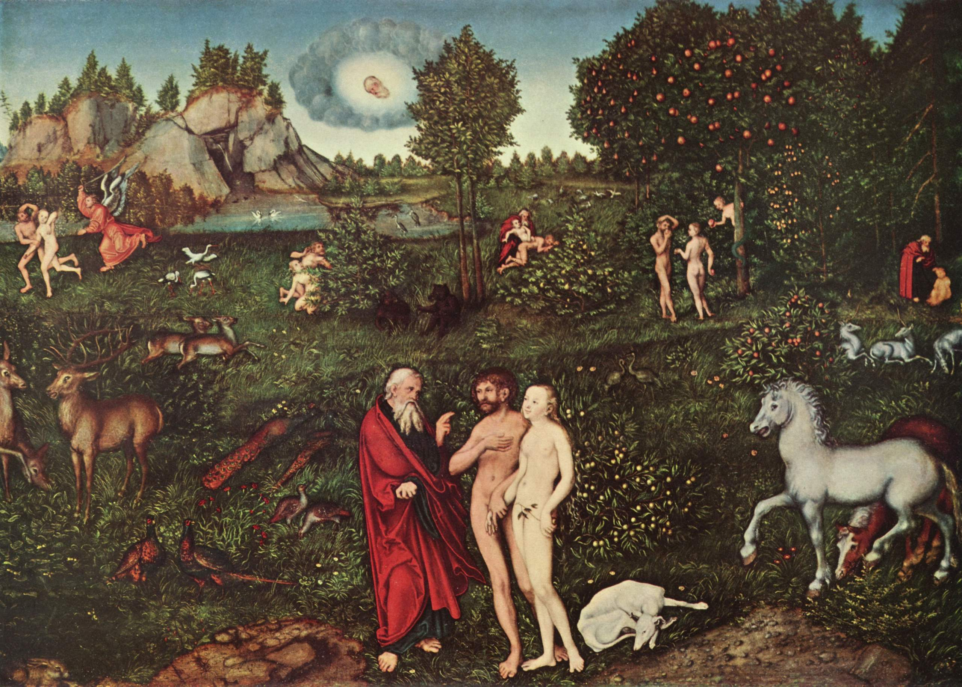

Slide 39
We need to remember that at the deepest level the ecological crisis is a profoundly spiritual and religious crisis …
“The violence present in our hearts, wounded by sin, is also reflected in the symptoms of sickness evident in the soil, in the water, in the air and in all forms of life”
(Laudato Si’, 2)

Slide 40
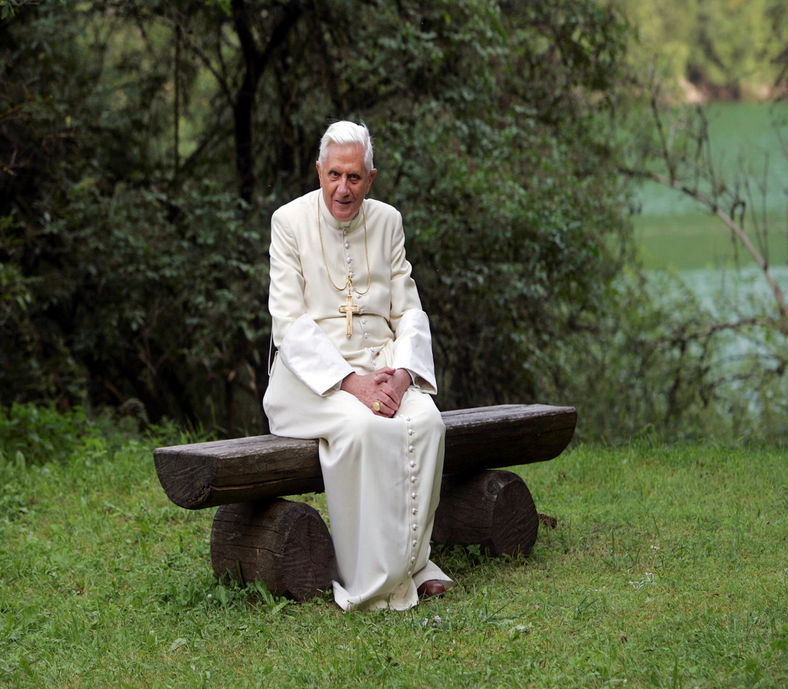
«the external
deserts are expanding
because the internal
deserts have become
so vast …
(Pope Benedict XVI,
2005)
… Quoted by Pope Francis in Laudato Si’, 217

Slide 41
«… human life is grounded
in three fundamental and closely
intertwined relationships:
with God, with our neighbour
and with the earth itself.
According to the Bible, these three vital relationships have been broken,
both ourwardly and within us.
This rupture is sin.»
(LS, 66)

Slide 42
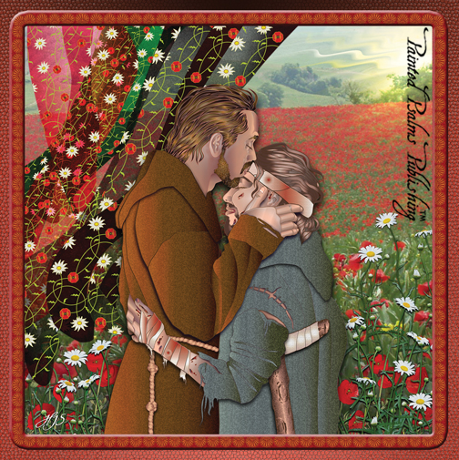

Slide 43
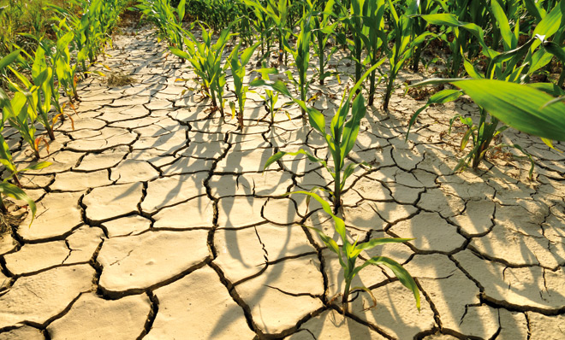
5.
Recognising
the ‘deeper’ roots
of the crisis

Slide 44
«It would hardly be helpful
to describe the symptoms
without acknowledging
the human origins
of the eco-logical crisis.»
(LS, 101)

Slide 45
According to Pope Francis,
to get to the deeper human roots
of the contemporary ecological crisis,
we need to get to the underlying
conceptual foundations of the reigning
dominant technocratic paradigm.
… the deeper roots of the crisis:
modern anthropocentrism and the mechanistic vision of the natural world (see LS, 106)
(influence of Romano Guardini) ...

Slide 46
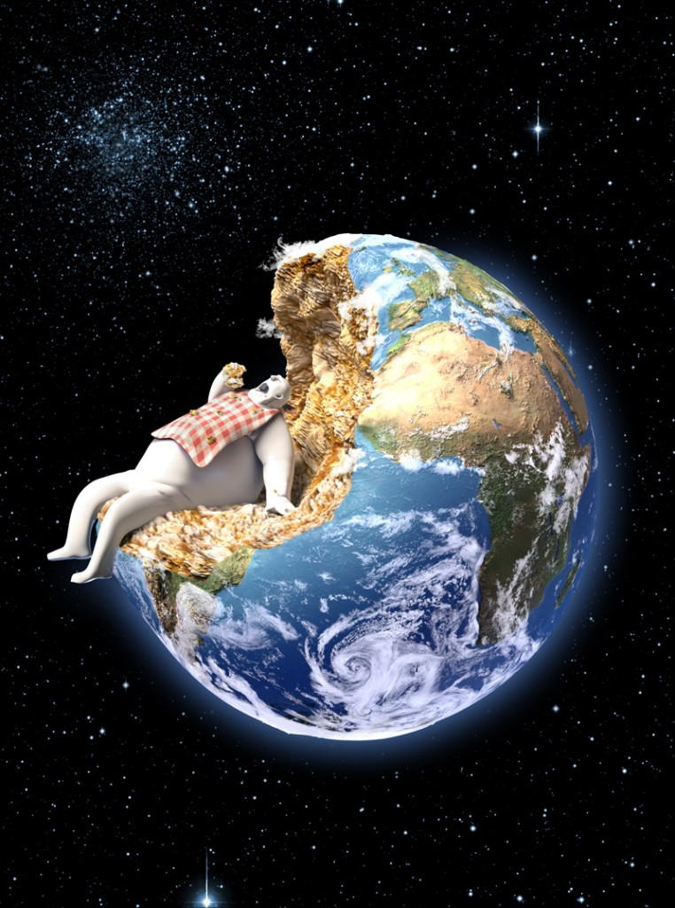
“Modern
Anthropocentrism …
… total independence
and absolute centrality …
…… human beings are the one
and only point of reference …
(“all else becomes relative”
(LS, 122)
… a distorted view of the
relationship between
Humanity and the natural
world … … “a Promethean vision of mastery over the world”
(LS, 116)

Slide 47
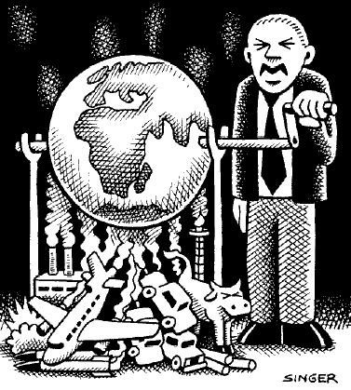
“A mechanistic conception
of the natural world –
Earth as a storehouse
of resources …
… a secular, disenchanted
view of the natural world
… a certain desacralization
of nature …
… the industrial rationality
of modern economy
… infinite economic growth
… technological mastery

Slide 48
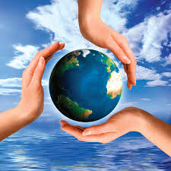
6.
An INTEGRAL
Response …

Slide 49
In the context of the ecological crisis, ensuring the habitability of our common planetary home becomes the most important of all common goods, as it is a necessary precondition for the fulfilment of the rest.
Here politics whose primary vocation is to serve the common good has an important and indispensable role to play.

Slide 50
A politics concerned with immediate re­sults, supported by consumerist sectors of the population, is driven to produce short-term growth. …
The myopia of power politics delays the inclu­sion of a far-sighted environmental agenda with­in the overall agenda of governments.
(LS, 178)

Slide 51

  Rediscover
  ECO-NOMIA as
  “managing/caring for our common home”
  (oikos + nomos)

Slide 52
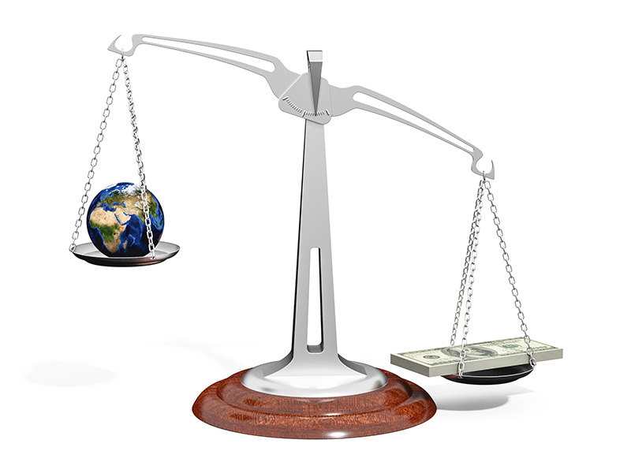

Slide 53
True oikonomia reflects the the ‘eucharistic’ vocation of human communities, namely to ‘share’ the gifts of creation with all the members of our common household in a spirit of communion (koinonia), like the one bread broken and shared at the table of the Lord.
The earth is indeed humankind’s common table laid by God for all. Around that table we gather, in a spirit of conviviality, not in competitive scramble but in joyful fellowship, nurturing and sheltering one another.

Slide 54
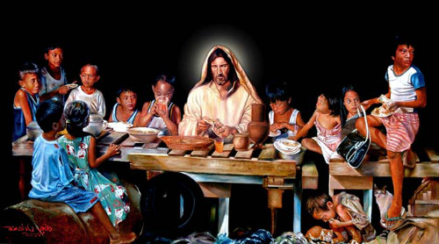

Slide 55
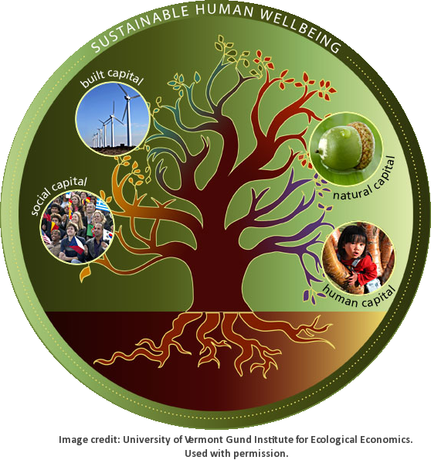
7. Walking the
Talk – the
EDUCATIONAL
Challenge …

Slide 56
«Many things have to change course,
but it is we human beings above all
who need to change. …
A great cultural, spiritual and educational challenge stands before us,
and it will demand that we set out
on the long path of renewal.
(Laudato Si’, 202)

Slide 57
Education in environmental re­sponsibility
can encourage ways of acting which directly
and significantly affect the world around us,
such as avoiding the use of plastic and paper, reducing water consumption, separating refuse, cooking only what can reasonably be consumed, showing care for other living beings,
using public transport or car-pooling,
planting trees, turning off unnecessary lights,
or any number of oth­er practices.
(Laudato Si’, 211)

Slide 58
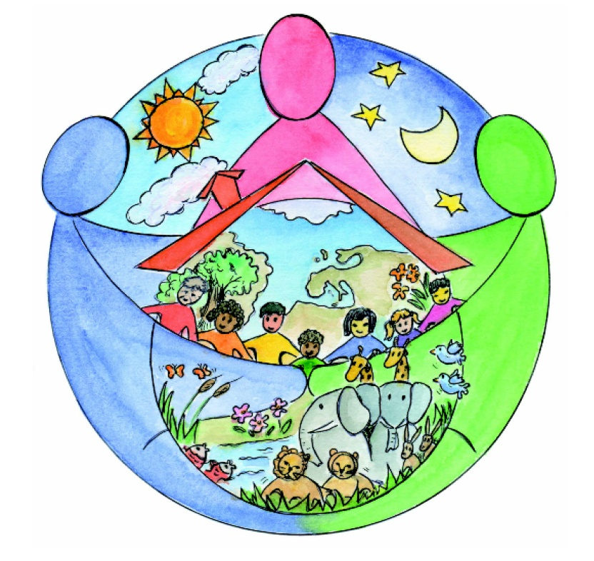

Slide 59
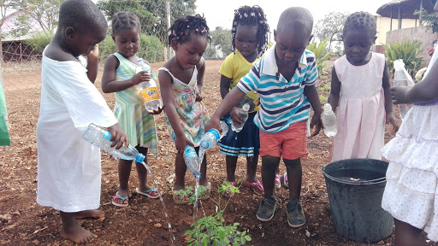

Slide 60
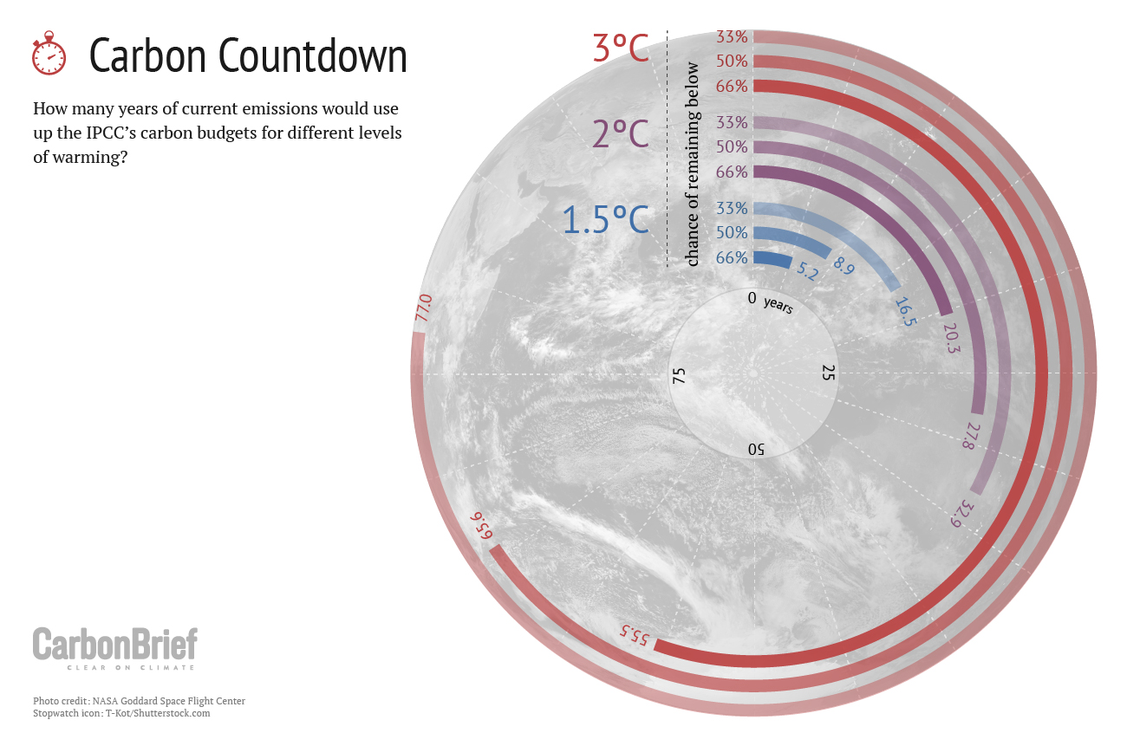
THE GREAT
URGENCY TO ACT

Slide 61
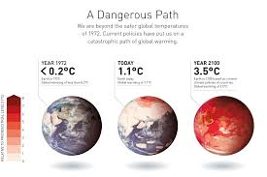

Slide 62
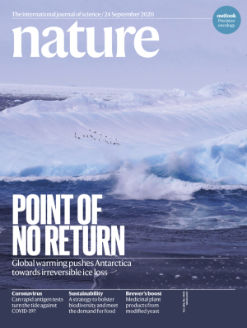

Slide 63
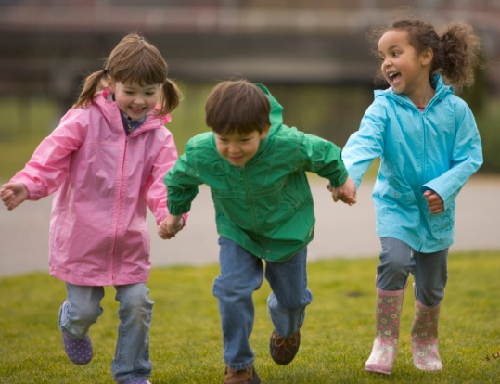
“What kind of world do we want to leave to those who come after us,
to children who are now growing up?” (Laudato si’, 160)

Slide 64
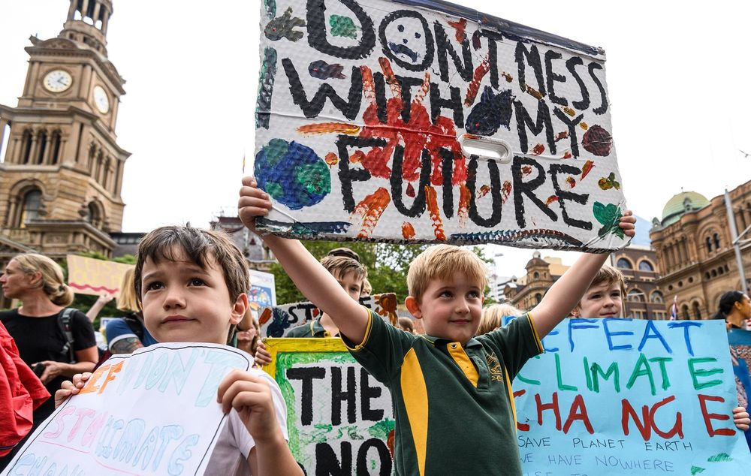

Slide 65
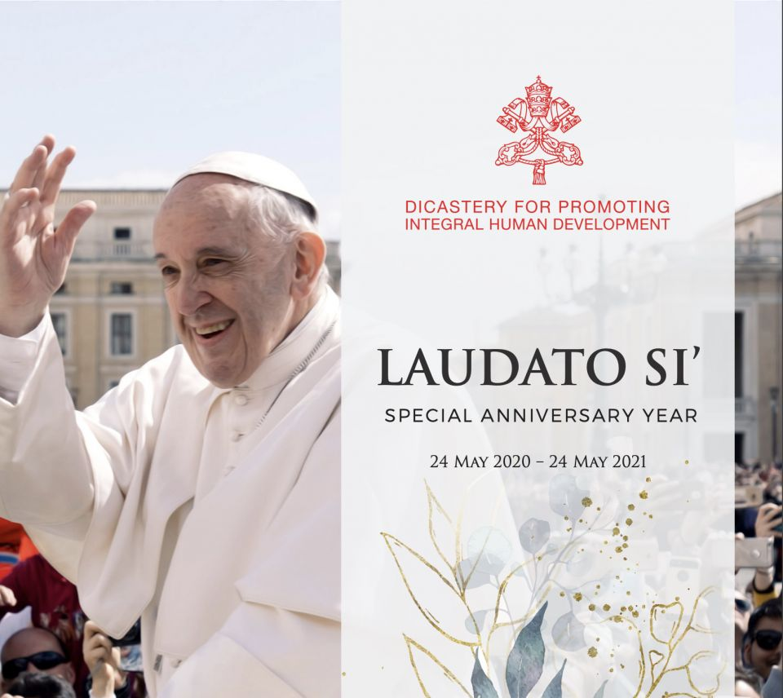
Caring for our common home is our original vocation
The stewardship of the earthly garden is the first and primary task entrusted to Adam - the first human being, as we read in the creation narratives in Genesis.
It is the very first commandment given to humanity.

Slide 66
LAUDATO SI’ ACTION PLATFORM
Laudato Si’ Multi-Year Roll-Out Plan
TO MAKE COMMUNITIES
AROUND THE WORLD
TOTALLY SUSTAINABLE
IN THE SPIRIT OF
THE INTEGRAL ECOLOGY
OF LAUDATO SI’

Slide 67
ECOLOGICAL CONVERSION
IN ACTION …
(A 7-year Journey)
1. Families
2. Communities
(Parishes, Dioceses, Basic Ecological Communities)
3. Educational Institutions
(Schools, Universities, et al.)
4. Hospitals and Health Care Centres
5. Businesses/Farms
6. Organizations
(NGOs, Foundations, Communication Centres, et al.)
7. Religious Orders

Slide 68
  7
  “LAUDATO SI’ GOALS
  (LSGs) in the spirit of integral ecology

Slide 69
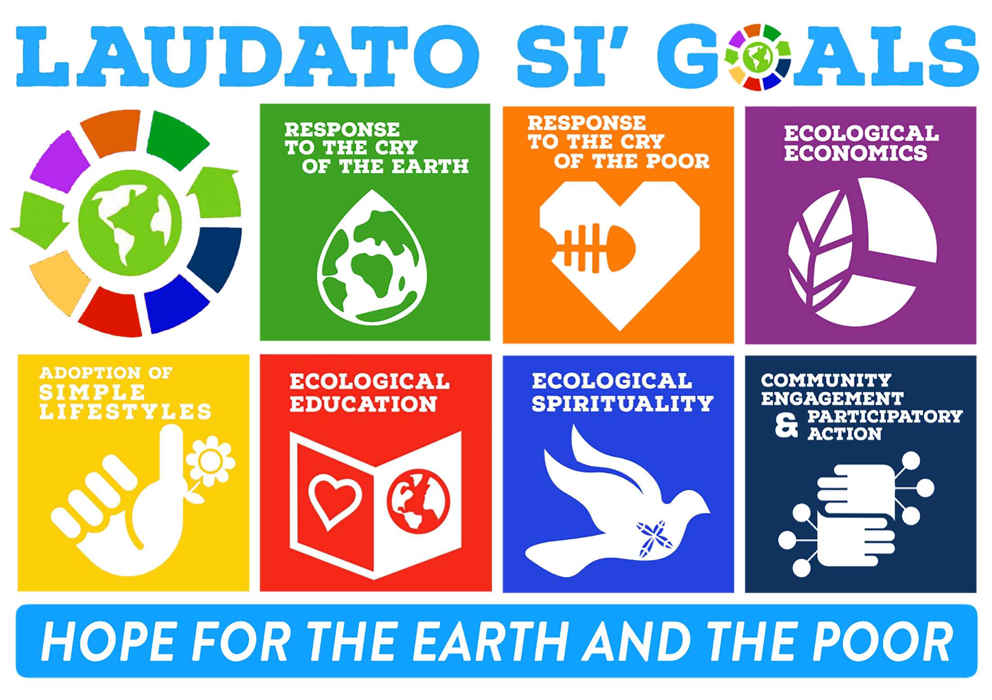
  7
  “LAUDATO SI’ GOALS
  (LSGs) in the spirit of integral ecology

Slide 70
* Implementing the LS Action Platform
We intend to begin in early 2021, by inviting a certain number of the above institutions to begin their 7-year journey of integral ecology in the spirit of Laudato Si’.
The following year we will encourage a new group, hopefully double the number of the previous group, to begin their 7-year journey, and so on.
In this way we are planning to grow a Laudato Si’ inspired network that continues to expand and grow exponentially each year. This will continue for each of the coming years of the new decade. In this way, we hope to arrive at a “critical mass” needed for radical societal transformation invoked by Pope Francis in Laudato Si’.

Slide 71


Slide 72


